Slide 1
Selected Topics for IT Security Applied Machine Learning for Cyber Security An Overview
Lecturer
Huang Xiao
xiaohu (at) in (dot) tum (dot) de
Chair for IT Security (I20), Prof. Dr. Claudia Eckert
Technische Universität München

Slide 2
Course Information
Vorlesung: 2 SWS / 4,0 ECTS-Credits
Veranstalter: Claudia Eckert
Zeit und Ort: Mi, 17:00 – 19:00 Uhr, 00.013.009
Beginn: Mittwoch, 13.04.2016
Ende: Mittwoch, 13.07.2016
Prüfung: Mündliche Prüfung
Website: https://www.sec.in.tum.de
Questions to the course, please contact:
Thomas Kittel (kittel@sec.in.tum.de)

Slide 3
Topics
13.04.2016: Huang Xiao – Applied Machine Learning on Cyber Security: An Overview
20.04.2016: Huang Xiao – Adversarial Learning: AI as a New Security Target
27.04.2016: Thomas Kittel, Sergej Proskurin – Virtual Machine Introspection
04.05.2016: Alexander Malkis – Proving security properties of multithreaded programs
11.05.2016: Steffen Wagner – Trusted Computing: TPM2.0
18.05.2016: Julian Kirsch – Semi-automated Reverse Engineering Techniques Targeting Contemporary Malware
25.05.2016: Julian Schütte – Android Application Security
01.06.2016: George Webster – Large Scale Malware Analysis
08.06.2016: Apostolis Zarras – Internet of Things: A Playground for Hacking
15.06.2016: Johann Heyszl – Embedded System Security: Common Pitfalls and Solutions
22.06.2016: Andreas Ibing – Symbolic Execution for Automated Bug Detection
29.06.2016: Sascha Wessel, Michael Weiß – Container-Technologie, OS Architectures, trust-me solution
06.07.2016: Paul Muntean – Control Flow based Security Techniques
13.07.2016: TbA

Slide 4
Outline
Introduction & Motivation
Machine Learning for Security
Research Subfields
Challenges & Discussion
References

Slide 5
Introduction
Information Technology as central role
Process, interpretation, transmission of information
Built on technological stacks, e.g., networks, sensors, computers
No perfect system exists
Information security is “good enough” solution
Goals: C-I-A triad
Data-driven Security

Slide 6
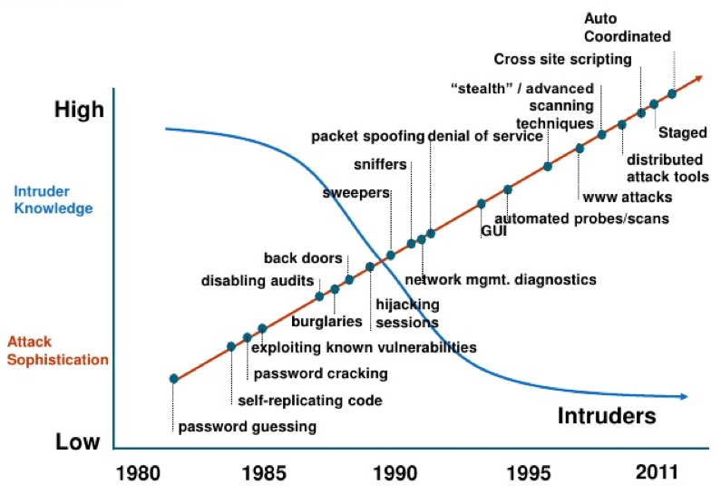
Motivation
Attack sophistication is increasing
Required expertise is decreasing
Quality of tools is improved constantly
Technological trends:
Big data, Cloud, IoT, Industry 4.0

Slide 7
Why now
Security Analysts are often overwhelmed
Data collection & Storage & Retrieving is well underway
Current detection techniques might fail on
Polymorphic malwares
Zero-day attacks
APTs
Dissolving network perimeter:
BYOD/Cloud

Slide 8
Generations of Security
Intrusion Detection Systems (IDSs)
Layered security
High false positive
Security Information and Event Management
Alert correlation
Actionable Information
Big data analytics for security
Context awareness

Slide 9
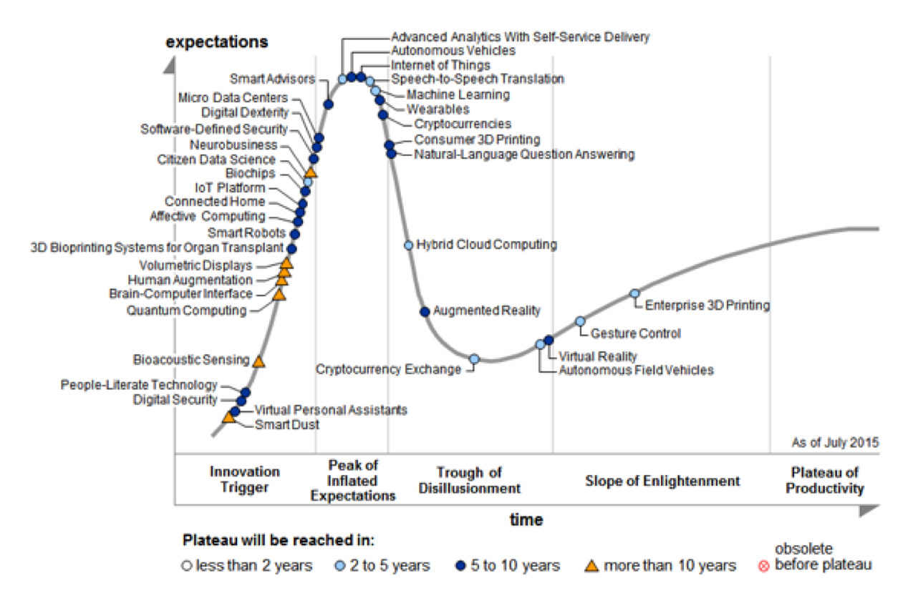
Technology hype ~5 years
Machine learning
Digital security
Data driven security
Source: Gartner (August 2015) Hype cycle

Slide 10
Digital Security
Rising research direction in IT security
Driven by Machine learning / data mining techniques
Huge amount of data generated
2010 Verizon: 86% cases of breach, evidence was in logs
How do we make sense of data?
What machine learning can not do for now? Cyber Security

Slide 11
Outline
Introduction & Motivation
Machine Learning for Security
Research Subfields
Challenges & Discussion
References

Slide 12
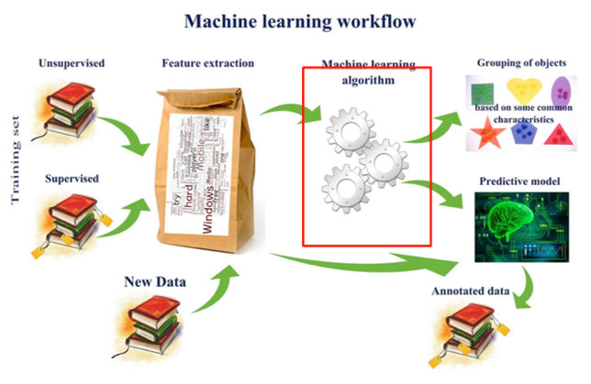
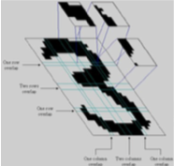
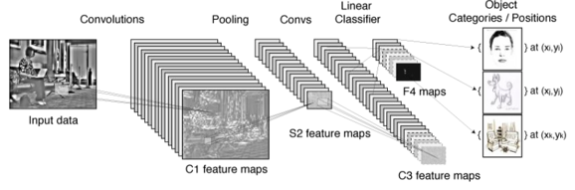
Introduction of Machine Learning
Fast pacing AI development
~70s-80s: Pattern Recognition
Based on rules, logic, expert knowledge
Automate tasks by program
~90s - now: Machine learning
Uncertainty introduced by Pearl et al.
Learning models from seen data samples (historical view)
Focus on prediction
E.g., SVM, decision tree, Naïve Bayes, etc…
2006 - now: Deep learning
Renaissance of NNs
Unsupervised feature learning
Learning non-local patterns
Mimic how cortex works
No theoretical ground so far
Works like a charm

Slide 13
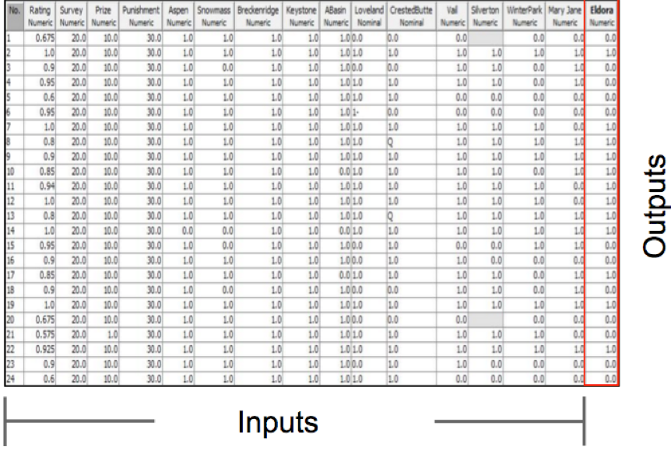
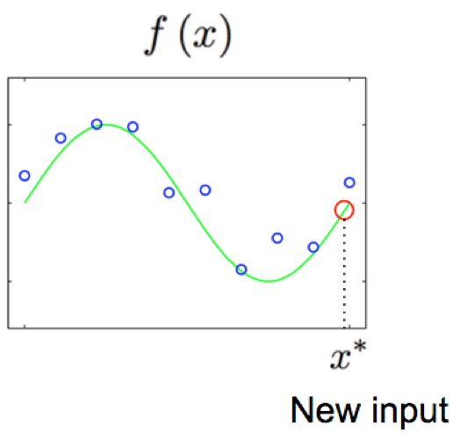
Make sense of the data
Given a dataset (X, y) consists of N rows（samples）, we learn a function f(x) that can predict unseen samples with minimal errors.
y (possibly not available)
X

Slide 14
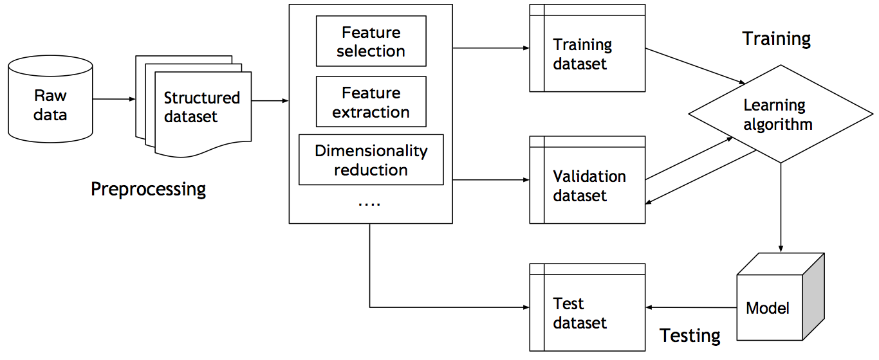
Learning Process
2. Feature engineering
3. Training model
1. Clean, format, structure the raw data
3a. Validating learning
4. Output model
5. Test unseen samples

Slide 15
Learning Schema
Representation | Evaluation | Optimization
Instance based Support vectors K-nearest neighbor Tree based Decision trees Random forest Graphical models Bayesian networks HMM | Accuracy or error rate Precision and recall Squared error F1 score KL divergence Likelihood Cross entropy | Greedy search Gradient descent Conjugate gradient Newton method Stoc. gradient descent Linear programing Quadratic programing

Slide 16
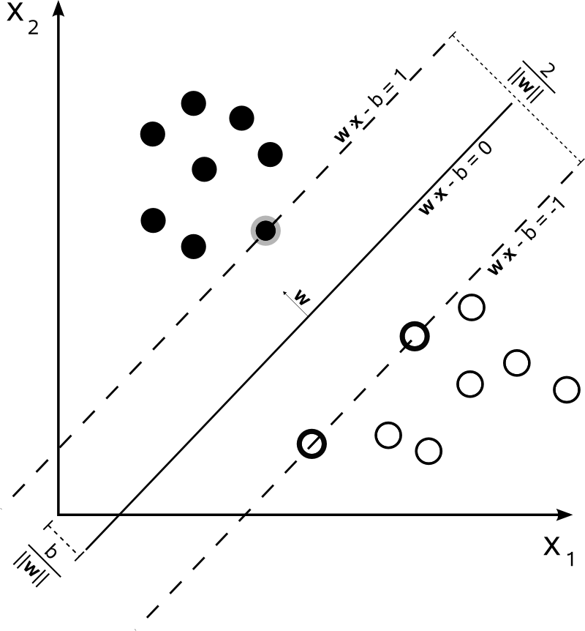
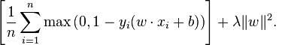
Example: SVM binary classification
Given N samples and labels , find the maximal margin that separate both classes of samples.
Minimize the objective functions
Hinge-loss
Regularization
Effect of optimization
Misclassified error is minimal
Separating hyperplane is not too complex

Slide 17
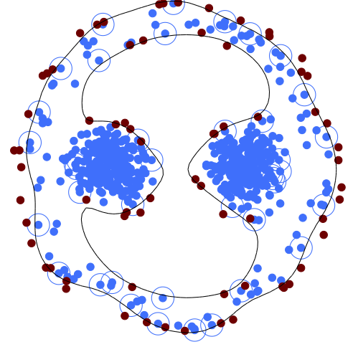
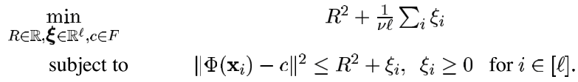
Example: One-class classification
Given N samples and without labels, find an optimal data description of the majority class of the data samples. The rest is regarded as anomalies (outliers)
Learn a hypersphere of the data support
R: the radius of the hypersphere

Slide 18
Make Sense of the Security
Data sources
Host based system calls, sys logs Network-based Inbound/outbound traffic Application logs DB logs, web logs IDS sensor alerts low level alarms Behaviour based mouse, keystrokes command lines Signatures databases
Make sense of it
Detection Correlations Clusterings/Similarities Attack vectors Threat models Temporal/Spatial Prevention
online vs offline
misuse vs. anomaly based
continuous vs. periodic
passive vs proactive

Slide 19
Outline
Introduction & Motivation
Machine Learning for Security
Research Subfields
Challenges & Discussion
References

Slide 20
Botnets detection
Networks of machines compromised by malware
Threats:
Information/identity theft, DDoS, Software piracy, Spamming/Phishing…
Very prevalent threats
It’s easy, fun, and low risk …
Protocols: IRC, HTTP, IM, …
C&C: centralized, stared, hierarchical, random
Fast fluxing, evolving, traffic encryption

Slide 21
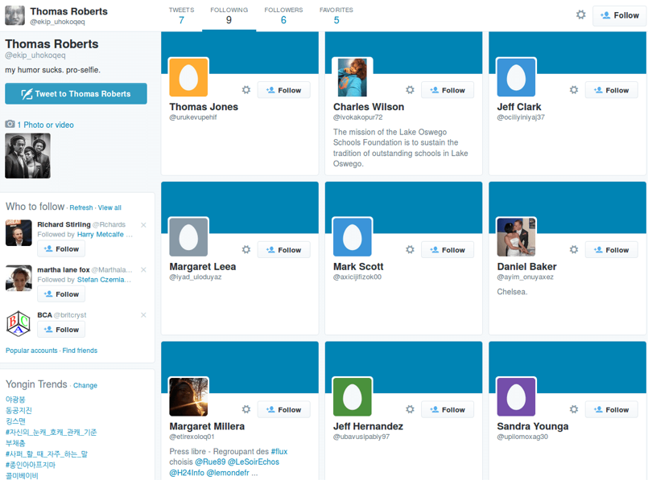
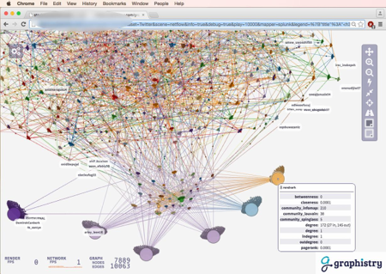
Botnets detection

Slide 22
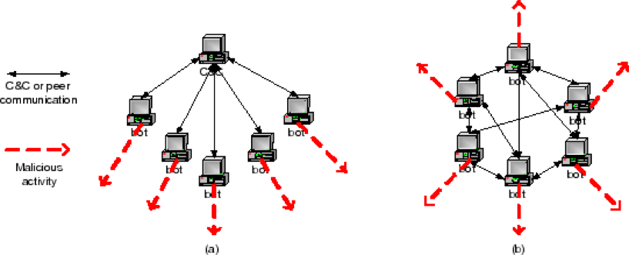
BotMiner
Who is talking to whom?
C&C netflow patterns
Activity patterns
Who is doing what?
Guofei Gu, Roberto Perdisci, Junjie Zhang, and Wenke Lee. 2008. BotMiner: clustering analysis of network traffic for protocol- and structure-independent botnet detection. In Proceedings of the 17th conference on Security symposium (SS’08). USENIX Association, Berkeley, CA, USA, 139-154.

Slide 23
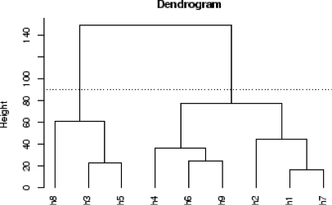
BotMiner
C-Plane features | e.g., #flows per hour (fph) #packets per flow (ppf) avg. #bytes per packets (bpp) avg. #bytes per second (bps)
A-Plane features | e.g., scanning, spam, binary downloading, exploit
hierarchical clustering
Output: clusters of machines
Bot or not?

Slide 24
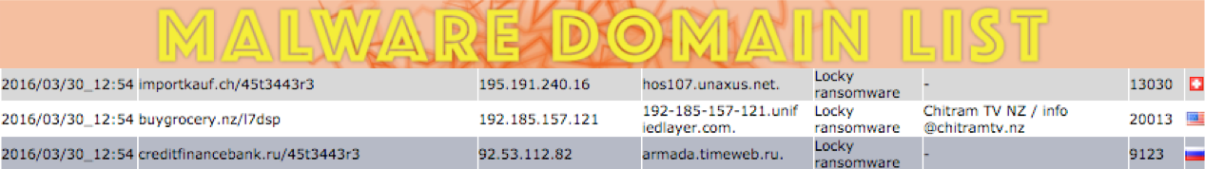
Malicious Domains/URLs
Malware samples from www.malwaredomainlist.com
Bots to locate C&C
Links to phishing/spam/scam server
Drive-by downloads

Slide 25
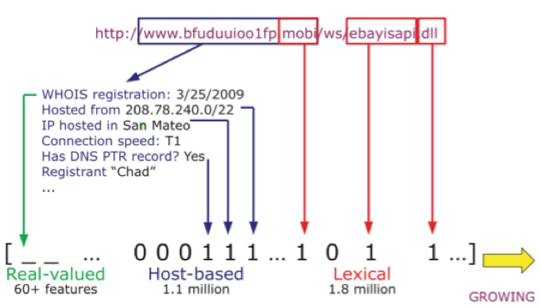
Learning malicious URLs
Features
IP address properties WHOIS records Domain TTL Blacklist membership Geographic prop. Connections speed bag of words record every token Separate domain levels, host, path Sparse representation
Online Classifiers
Perceptron Stochastic gradient descent Confident weighted Passive aggressive
Data sources: 100 days, 20,000 URLs/day
Host-based
lexical-based
Ma, J., Saul, L.K., Savage, S. and Voelker, G.M., 2011. Learning to detect malicious URLs. ACM Transactions on Intelligent Systems and Technology, 2(3)., pp.1–24.

Slide 26
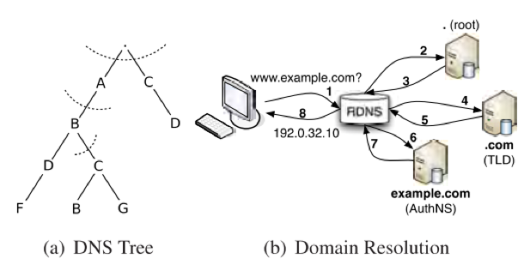
Leveraging DNS traffic
Time-based | DNS answer based
short life daily similarity of requests repeating patterns access ratio | #distinct IP addresses #distinct countries #domains IP shared Reverse DNS query results
TTL value-based | Domain name based
Avg. TTL Std. TTL #distinct TTL # TTL Change %usg. of TTL range | %numerical characters %length of the longest meaningful substring
Features can be built from DNS traffic
Using C4.5 decision tree as classifier
Bilge, L. et al., 2011. EXPOSURE : Finding Malicious Domains Using Passive DNS Analysis. Ndss., pp.1–17
Antonakakis, M. et al., 2011. Detecting Malware Domains at the Upper DNS Hierarchy. USENIX Security Symposium., 11., pp.1–16.

Slide 27
Insider Attacks
Traitor or Masquerader
Attacks from inside
Threat: Inside > Outside
Types of threats are diverse:
exfiltration of data, unauthorised downloads, eavesdropping…
Basic idea: user behaviour modelling
Unix command lines
Mouse movements, keystrokes
Re-authentication, continuous authentication

Slide 28
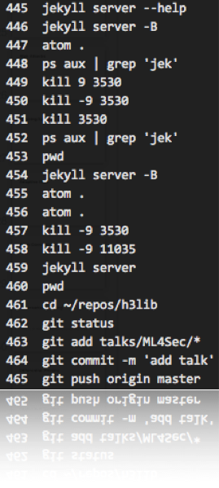
Unix shell commands modeling
Schonlau dataset
70 users
20 masquerade users
15,000 commands per user
Block size: 100
clean or dirty block
Bag of words for One-class SVM works well
Wang, K. and Stolfo, S.J., 2003. One-class training for masquerade detection. Workshop on Data Mining for Computer Security, Melbourne, Florida., pp.10–19.

Slide 29
Behavior Biometrics
(physical) What you are | (behavior) What you do | To detect an insider…
Fingerprint Retina pattern Voice | Handwritten signature Gait Keystrokes Mouse dynamics | Input interaction: mouse, keystrokes Application level: GUI events Habits, strategy Low-level: System traces Audit logs Registry access In/Outbound traffic

Slide 30
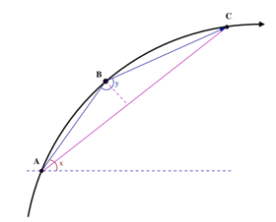
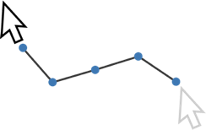
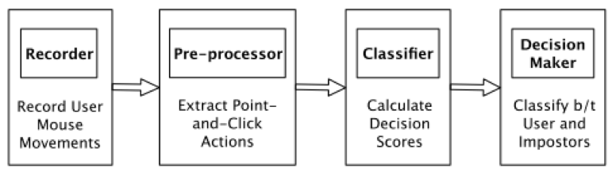
Mouse dynamics (cont. auth.)
Point-and-click patterns
Angle-based features
Using binary SVM classifier
Zheng, N., Paloski, A. and Wang, H., 2011. An efficient user verification system via mouse movements. Proceedings of the 18th ACM conference on Computer and communications security - CCS ’11., p.139

Slide 31
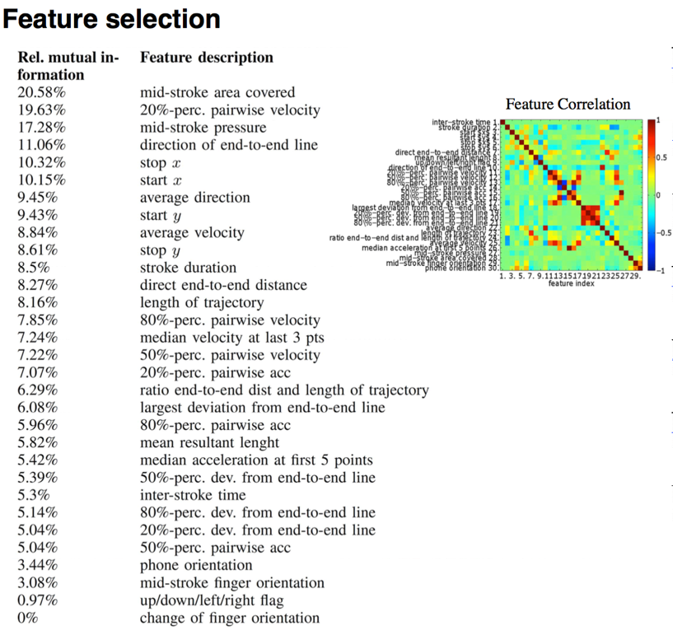
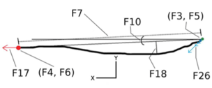
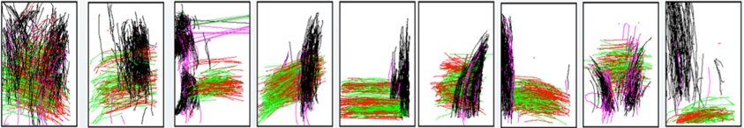

Touchalytics (cont. auth.)
Frank, M. et al., 2013. Touchalytics: On the applicability of touchscreen input as a behavioral biometric for continuous authentication. IEEE Transactions on Information Forensics and Security, 8(1)., pp.136–148.

Slide 32
Web Attacks
Attacks on web applications
Types: SQLi, RFI, LFI, XSS, DT, CS, etc…
Web Server Logs: conform to CLF (Common Log Format)
remotehost rfc931 authuser [date] "request" status bytes
Misuse-based vs. Anomaly-based
Misuse: match signature databases
Anomaly: able to detect unknown patterns
Application oriented multi-modal IDS

Slide 33
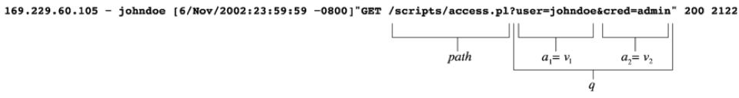
Web Attacks
model anomaly score
Multi-modal
1
2
…
N
Example (log entry):
Web app
Features
attribute length
attribute grammer
attribute presence
attribute order
character distribution
requests time delay
token finder
invocation order
Query strings
?attr=val
feature anomaly score
Kruegel, C., Vigna, G. and Robertson, W., 2005. A multi-model approach to the detection of web-based attacks. Computer Networks, 48(5)., pp.717–738.

Slide 34
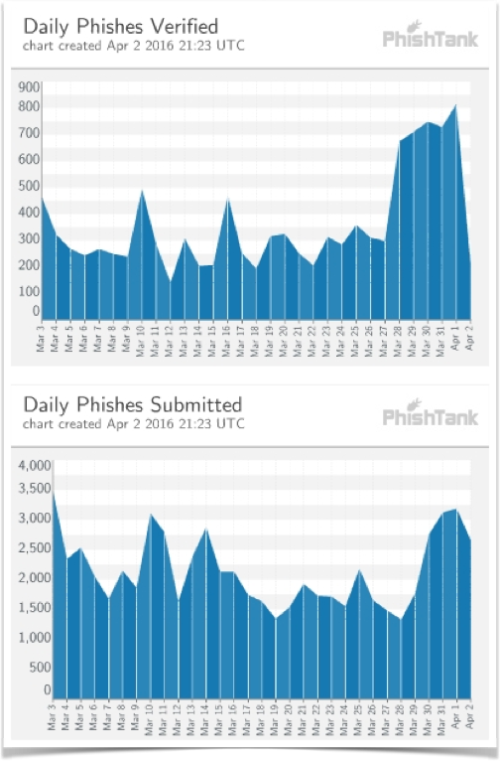
Phishing/Spam
Normally legitimate-like website/Email
Detection tools:
Spoofguard, Netcraft, SpamAssasin …
Domain/Content based features
source: PhishTank

Slide 35
Phishing/Spam
Features
IP-based URL linked-to domain age href/text of link matched “here” link Number of links Number of domains Number of dots If contains javascript Spam filter output | http://192.168.0.1/paypal.cgi?fix account less than 60 days? <a href="badsite.com"> paypal.com</a> links to other domain links by <a> tags with href attribute main part of domain name counts more dots is suspicious find text ‘javascript’ result by spam detector
Fette, I., Sadeh, N. and Tomasic, A., 2007. Learning to detect phishing emails. Proceedings of the 16th international conference on World Wide Web - WWW ’07., p.649

Slide 36
Adaptive IDS
Diverse network environments
Possibly adversarial environment
Single modal IDS not robust
Dynamic attack landscape
Heterogeneous data sources (no free lunch)
Multiple Classifier System (MCS)
Goal: adaptive to changes

Slide 37
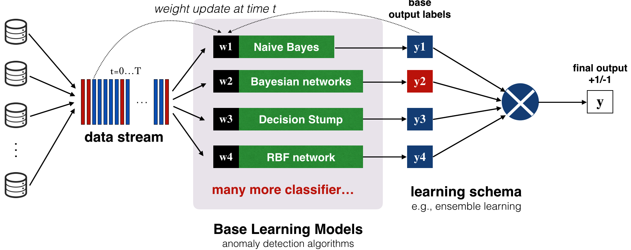
Adaptive IDS
Nguyen, H.T. and Franke, K., 2012. Adaptive Intrusion Detection System via online machine learning. Proceedings of the 2012 12th International Conference on Hybrid Intelligent Systems, HIS 2012., pp.271–277.

Slide 38
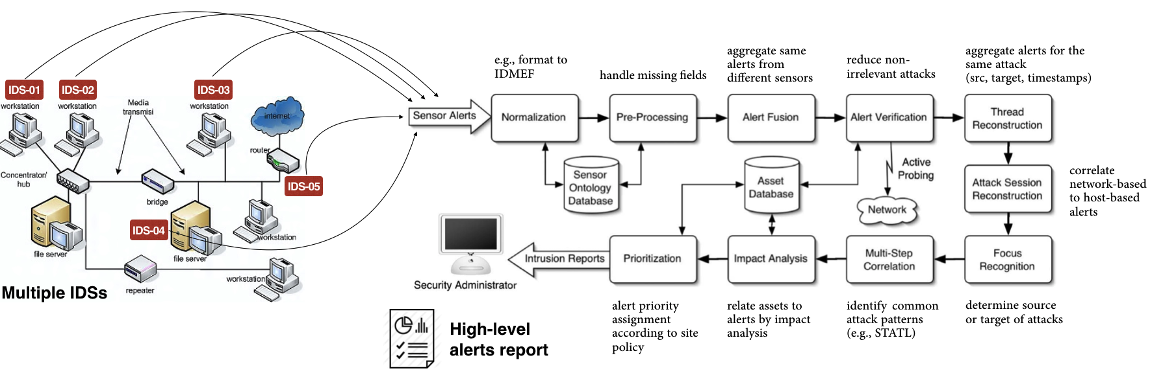
Alert Correlation
F. Valeur, G. Vigna, C. Kruegel and R. A. Kemmerer, "Comprehensive approach to intrusion detection alert correlation," in IEEE Transactions on Dependable and Secure Computing, vol. 1, no. 3, pp. 146-169, July-Sept. 2004.

Slide 39
Adversarial Learning
What if a bot learns to behave like a legitimate user?
Learning algorithm itself can also be a security target
Data stationary assumption is broken
Attacks: Causative or Evasive
Passive or proactive arm-races
Aim to design learning algorithms robust to adversaries

Slide 40
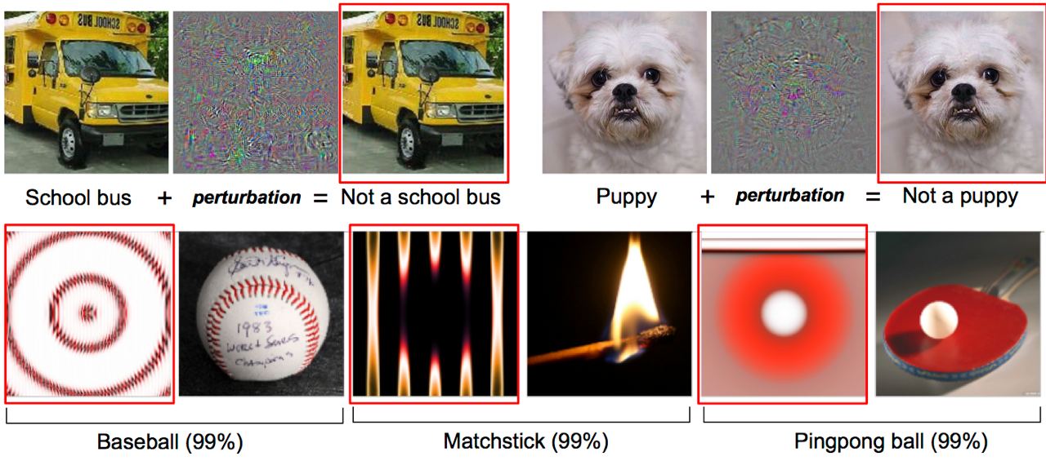
Adversarial Learning
Deep net is easily fooled
Nguyen, A., Yosinski, J. and Clune, J., 2014. Deep Neural Networks are Easily Fooled: High Confidence Predictions for Unrecognizable Images. In Computer Vision and Pattern Recognition 2015. Boston, Massachusetts, US.

Slide 41
Differential Privacy
Big data is booming up, but privacy is less considered
Sensitive information can be inferred from statistics
Differential privacy: even only aggregated statistics is published from samples, we can never tell/infer anything about a particular user.
Examples:
AOL search results scandal
Facebook ads -> unclose private information
Netflix competition

Slide 42
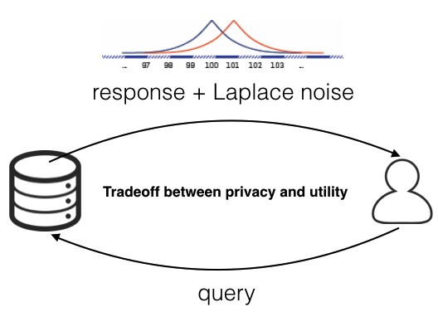
Differential Privacy
Name | Age | Smoke | Lung cancer
Ian Jonathan | 57 | Yes | Positive
Kelly Nyn | 60 | Yes | Positive
Christ Lee | 48 | No | Negative
Tim Kingston | 68 | No | Negative
Mark Spring | 35 | Yes | Negative
Liu Han | 78 | No | Positive
Yoshua Hiro | 40 | Yes | Negative
E.g., query age(Jerry), response could be 55, 56, 58, 53 …
Statistics: Prob(lung cancer)=1 where age>50 & smoke=Yes
What if Jerry, age=55, smoke=Yes, … privacy leak
Dwork, C., 2008. Differential Privacy: A Survey of Results. In Theory and Applications of Models of Computation. pp. 1–19., pp.1–19

Slide 43
Outline
Introduction & Motivation
Machine Learning for Security
Research Subfields
Challenges & Discussion
References

Slide 44
Challenges
Outlier detection is hard
High cost of errors (false alarm)
Lack of appropriate training data
Anomalous class is rare
Interpretation of results
How to explain the attacks?
Variability in network traffic
Attack patterns evolve
Adaptive adversaries
Evaluation difficulties

Slide 45
References
Emilio Ferrara, Onur Varol, Clayton A. Davis, Filippo Menczer, Alessandro Flammini: The Rise of Social Bots. CoRR abs/1407.5225 (2014)
Guofei Gu, Roberto Perdisci, Junjie Zhang, and Wenke Lee. 2008. BotMiner: clustering analysis of network traffic for protocol- and structure-independent botnet detection. In Proceedings of the 17th conference on Security symposium (SS’08). USENIX Association, Berkeley, CA, USA, 139-154.
Ma, J., Saul, L.K., Savage, S. and Voelker, G.M., 2011. Learning to detect malicious URLs. ACM Transactions on Intelligent Systems and Technology, 2(3)., pp.1–24.
Bilge, L. et al., 2011. EXPOSURE : Finding Malicious Domains Using Passive DNS Analysis. Ndss., pp.1–17
Antonakakis, M. et al., 2011. Detecting Malware Domains at the Upper DNS Hierarchy. USENIX Security Symposium., 11., pp.1–16.
Wang, K. and Stolfo, S.J., 2003. One-class training for masquerade detection. Workshop on Data Mining for Computer Security, Melbourne, Florida., pp.10–19.
Zheng, N., Paloski, A. and Wang, H., 2011. An efficient user verification system via mouse movements. Proceedings of the 18th ACM conference on Computer and communications security - CCS ’11., p.139
Frank, M. et al., 2013. Touchalytics: On the applicability of touchscreen input as a behavioral biometric for continuous authentication. IEEE Transactions on Information Forensics and Security, 8(1)., pp.136–148.
Kruegel, C., Vigna, G. and Robertson, W., 2005. A multi-model approach to the detection of web-based attacks. Computer Networks, 48(5)., pp.717–738.
Fette, I., Sadeh, N. and Tomasic, A., 2007. Learning to detect phishing emails. Proceedings of the 16th international conference on World Wide Web - WWW ’07., p.649
Nguyen, H.T. and Franke, K., 2012. Adaptive Intrusion Detection System via online machine learning. Proceedings of the 2012 12th International Conference on Hybrid Intelligent Systems, HIS 2012., pp.271–277.
F. Valeur, G. Vigna, C. Kruegel and R. A. Kemmerer, "Comprehensive approach to intrusion detection alert correlation," in IEEE Transactions on Dependable and Secure Computing, vol. 1, no. 3, pp. 146-169, July-Sept. 2004.
Nguyen, A., Yosinski, J. and Clune, J., 2014. Deep Neural Networks are Easily Fooled: High Confidence Predictions for Unrecognizable Images. In Computer Vision and Pattern Recognition 2015. Boston, Massachusetts, US.
Xiao, H. et al., 2015. Is Feature Selection Secure against Training Data Poisoning ? Int’l Conf. on Machine Learning (ICML), 37.
Xiao, H. et al., 2014. Support Vector Machines under Adversarial Label Contamination. Journal of Neurocomputing, Special Issue on Advances in Learning with Label Noise, 160(0)., pp.53–62.
Dwork, C., 2008. Differential Privacy: A Survey of Results. In Theory and Applications of Models of Computation. pp. 1–19., pp.1–19

